Slide 1

History and Generation of Computers
BSC.CSIT, FIRST SEMESTER

Slide 2
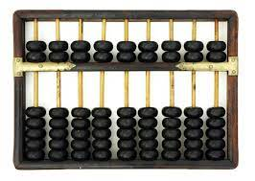
HISTORTY
1.Abacus:
The abacus is also called a counting frame, is a calculating tool which has been used since ancient times.
It was used in the ancient near East, Europe, China, and Russia, millennia before the adoption of the Hindu-Arabic numeral system.
The exact origin of the abacus has not yet emerged.
It consists of rows of movable beads, or similar objects, strung on a wire. They represent digits.
One of the two numbers is set up, and the beads are manipulated to perform an operation such as addition, or even a square or cubic root.

Slide 3
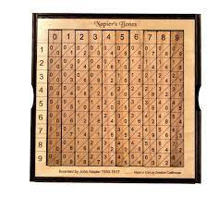
2.Napier’s Bone
Napier's bones is a manually-operated calculating device created by John Napier of Merchiston,
Scotland for the calculation of products and quotients of numbers.
The method was based on lattice multiplication, and also called rabdology, a word invented by Napier.
Napier published his version in 1617.
] It was printed in Edinburgh and dedicated to his patron Alexander Seton.
Using the multiplication tables embedded in the rods, multiplication can be reduced to addition operations and division to subtractions.
Advanced use of the rods can extract square roots.
Napier's bones are not the same as logarithms, with which Napier's name is also associated, but are based on dissected multiplication tables

Slide 4
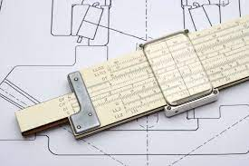
3.SLIDE RULE
The English mathematician and clergyman Reverend William Oughtred and others developed the slide rule in the 17th century based on the emerging work on logarithms by John Napier
Before the advent of the electronic calculator, it was the most commonly used calculation tool in science and engineering.
The slide rule's ease of use, ready availability, and low cost caused its use to continue to grow through the 1950s and 1960s, even as electronic computers were being gradually introduced.
The introduction of the handheld electronic scientific calculator around 1974 made slide rules largely obsolete, and most suppliers left the business.

Slide 5
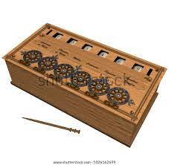
4.PASCALINE
Blaise Pascal began to work on his calculator in 1642, when he was 18 years old.
He had been assisting his father, who worked as a tax commissioner, and sought to produce a device which could reduce some of his workload.
Pascal received a Royal Privilege in 1649 that granted him exclusive rights to make and sell calculating machines in France.
This was a major influence on the next mechanical calculator design made by Tom Monaghan.

Slide 6
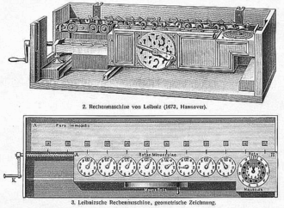
5.STEPPED RECKONER
The stepped reckoner or Leibniz calculator was a mechanical calculator invented by the German mathematician Gottfried Wilhelm Leibniz around 1672 and completed in 1694.
The name comes from the translation of the German term for its operating mechanism, Staffelwalze, meaning "stepped drum".
It was the first calculator that could perform all four arithmetic operations.
Its intricate precision gearwork, however, was somewhat beyond the fabrication technology of the time; mechanical problems, in addition to a design flaw in the carry mechanism, prevented the machines from working reliably.

Slide 7
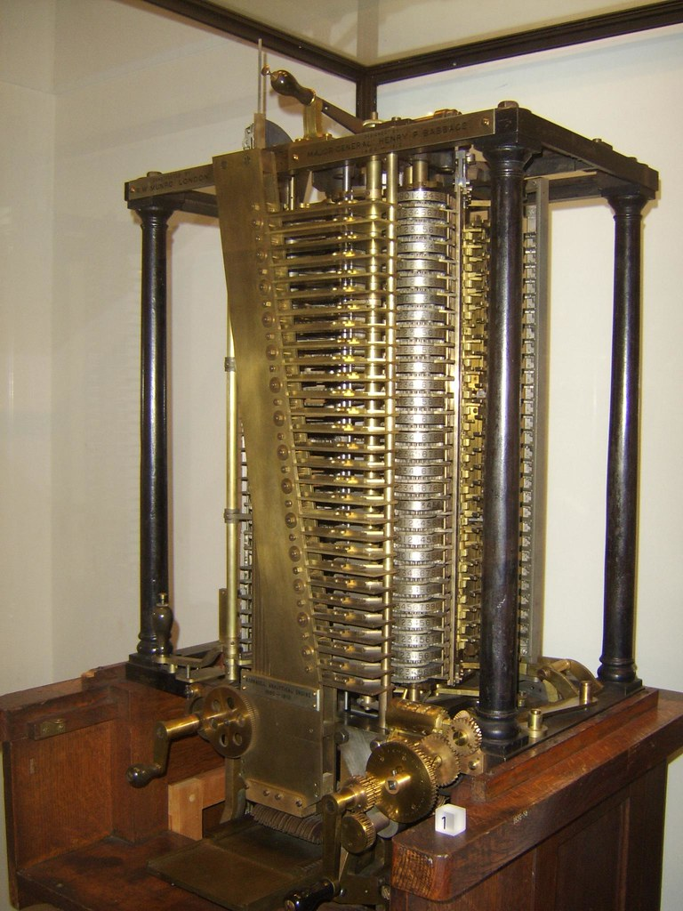
6.ANALYTICAL ENGINE
The Analytical Engine was a proposed mechanical general-purpose computer designed by English mathematician and computer pioneer Charles Babbage.
It was first described in 1837 as the successor to Babbage's difference engine, which was a design for a simpler mechanical calculator.
The Analytical Engine incorporated an arithmetic logic unit, control flow in the form of conditional branching and loops, and integrated memory, making it the first design for a general-purpose computer that could be described in modern terms as Turing-complete.
In other words, the structure of the Analytical Engine was essentially the same as that which has dominated computer design in the electronic era.
The Analytical Engine is one of the most successful achievements of Charles Babbage.

